Slide 1
Remote Labs Suggested Changes

Slide 2
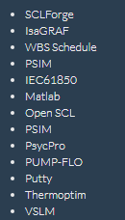
Homepage Description
Issue/Fix
Screenshot
Dot points needed to be added to the options available for a lab.
Before
After

Slide 3
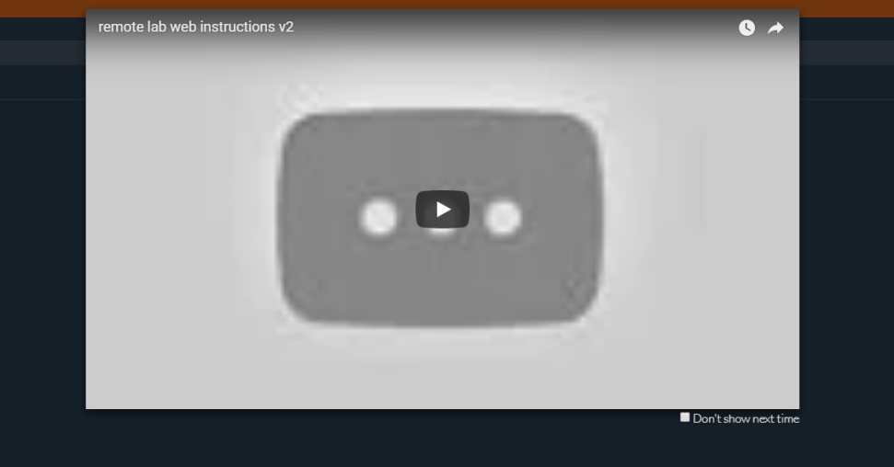
Instruction Video
Issue/Fix
Screenshot
Instruction video needs to be updated.
I will make a video once the final touches to the Remote Lab have been made.

Slide 4
Instruction Video V2
Issue/Fix
Screenshot
The instruction video keeps playing if you click off it.
Automatically stop if from playing on leaving the video.

Slide 5

Header Declaration
Issue/Fix
Screenshot
The title ‘List of available remote labs’ should be wrapped in a header tag.
Wrap it in either an ‘<h1>’ or ‘<h2>’. This will allow me to target it with CSS.

Slide 6
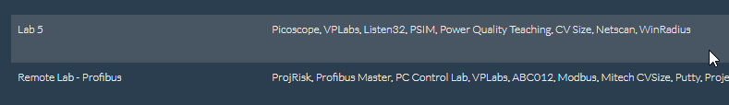
Lab Selection Text Positioning
Issue/Fix
Screenshot
The text within each row of the table should be centred.

Slide 7
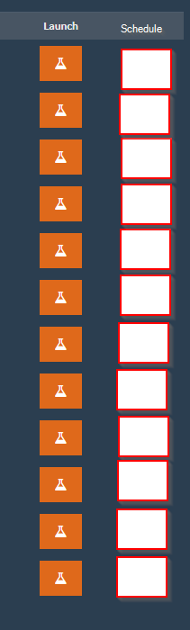
Lab Selection Text Positioning
Issue/Fix
Screenshot
Schedule booking for the platform should be available. A similar concept is utilised here: https://www.spacecubed.com/en/page/book-open-house

Slide 8
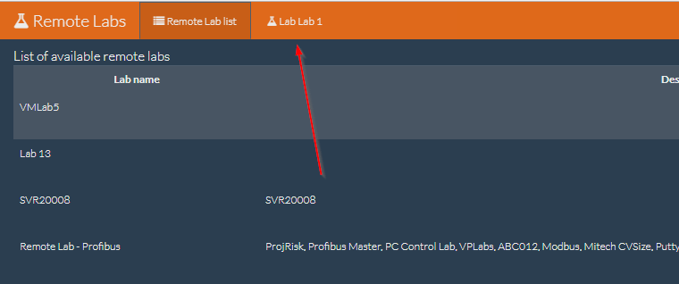
Only One Lab at a Time
Issue/Fix
Screenshot
Only allow for one lab to be entered at a time. It is too messy having multiple tabs, as the program starts to crumble.

Slide 9
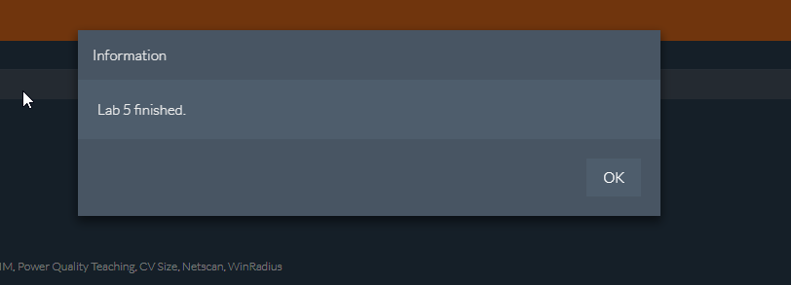
No ‘Lab Finished’ Warning Required
Issue/Fix
Screenshot
Remove the popup that informs users about the lab’s session concluding if they select ‘finish’.

Slide 10

Account Settings
Issue/Fix
Screenshot
When clicking on the email at the top right, it should display the option to log out from there.

Slide 11
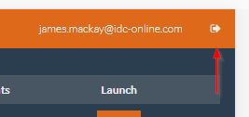
Account Settings Part 2
Issue/Fix
Screenshot
Remove this logout button.

Slide 12
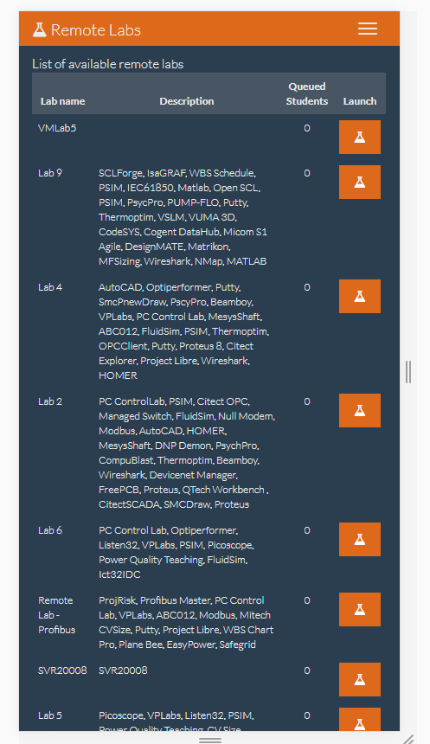
Homepage Mobile View
Issue/Fix
Screenshot
Hide the lab ‘Description’ text after anything less than 440px in size.

Slide 13

Unnecessary Hyperlink
Issue/Fix
Screenshot
The ‘Remote Labs’ hyperlink at the top left of the page has a ‘#’ link. It should simply contain the link ‘https://electromeet.com/RemoteLabWeb’.

Slide 14
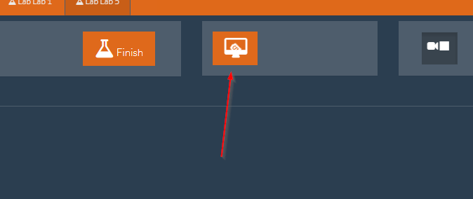
Only One Lab at a Time
Issue/Fix
Screenshot
This button should automatically be clicked when a lab is opened.

Slide 15
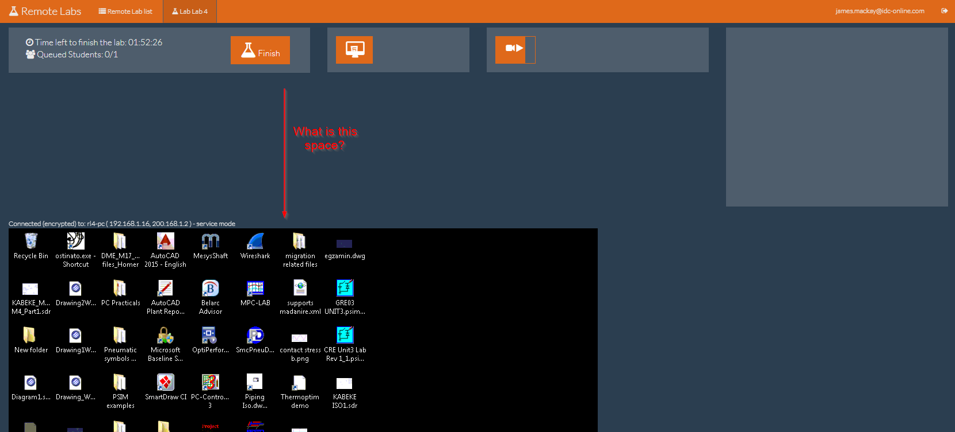
Webcam and Screen share Conflict
Issue/Fix
Screenshot
Enabling the webcam and screen share should NOT push the screen share view down.

Slide 16
Webcam and Screen share Conflict
Issue/Fix
Screenshot
Enabling the webcam and screen share should NOT push the screen share view down.

Slide 17
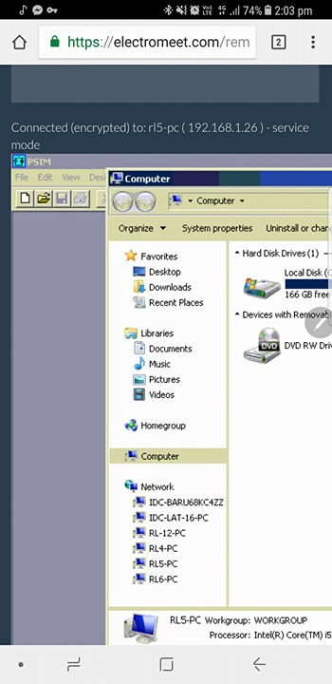
Screen Resizing
Issue/Fix
Screenshot
The VNC screen should resize depending on how small the screen is.
Add a 100% width on the screen / Teamviewer might be able to take care of it.

Slide 18
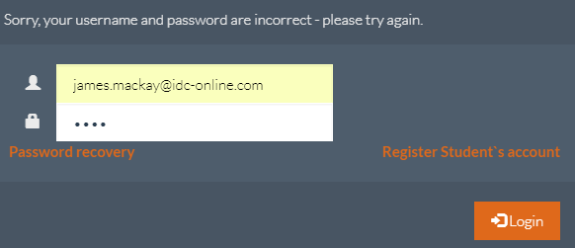
Login Popup
Issue/Fix
Screenshot
The ‘Password recovery’ text should be present immediately. It shouldn’t require the user to fail logging in once.

Slide 19
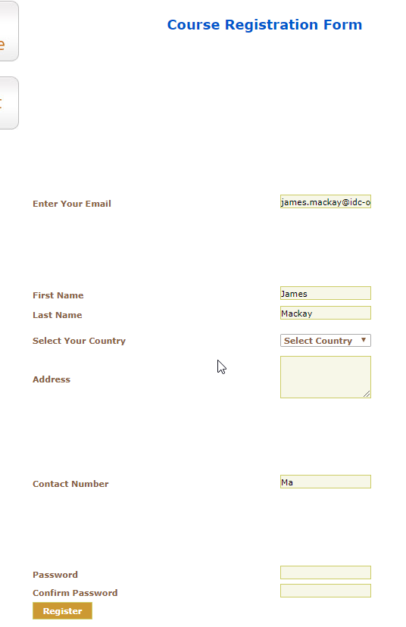
Registration Form
Issue/Fix
Screenshot
The registration form isn’t appealing to look at. The tab order is also a mess.
Complete redo of the form. Assuming this will be embedded on the new Electromeet website.

Slide 20
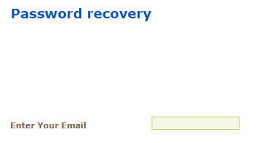
Password Recovery
Issue/Fix
Screenshot
Another page isn’t necessary. Selecting ‘Password recovery’ should simply send an email to the user with the updated details.

Slide 21
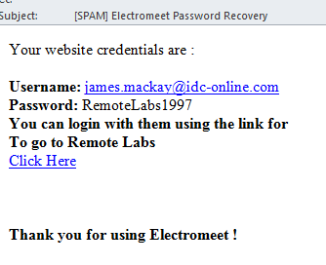
Email Received
Issue/Fix
Screenshot
Remove ‘[SPAM]’ from the subject line.
Change the bottom text to ‘Thankyou for using our Remote Labs’.

